Slide 1
GRAPH TRAVERSAL

Slide 2
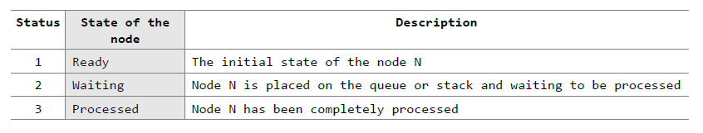
GRAPH TRAVERSAL ALGORITHMS
There are two standard methods of graph traversal .
1. Breadth-first search
2. Depth-first search
While breadth-first search uses a queue as an auxiliary data structure to store nodes for further processing, the depth-first search scheme uses a stack. But both these algorithms make use of a variable STATUS. During the execution of the algorithm, every node in the graph will have the variable STATUS set to 1, 2 or 3, depending on its current state.

Slide 3
Breadth-First Search
Breadth-first search (BFS) is a graph search algorithm that begins at the root node and explores all the neighboring nodes. Then for each of those nearest nodes, the algorithm explores their unexplored neighbor nodes, and so on, until it finds the goal.
That is
We start examining the node A and then all the neighbors of A are examined.
In the next step, we examine the neighbors of neighbors of A, so on and so forth.
This means that we need to track the neighbors of the node and guarantee that every node in the graph is processed and no node is processed more than once. This is accomplished by using a queue that will hold the nodes that are waiting for further processing and a variable STATUS to represent the current state of the node.

Slide 4
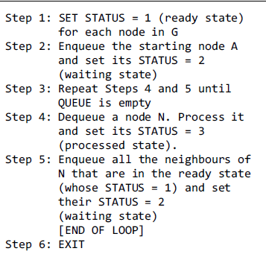
Breadth-First Search Algorithm

Slide 5
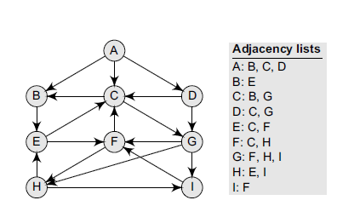
The adjacency list of G is also given. Assume that >G represents the daily flights between different cities > we want to fly from city A to I with minimum stops. That is, find the minimum path P from A to I given that every edge has a length of 1.
Consider the graph G given in Figure

Slide 6
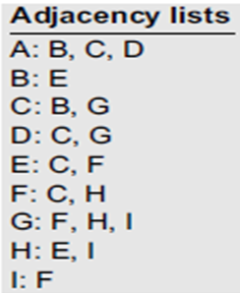
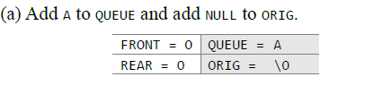
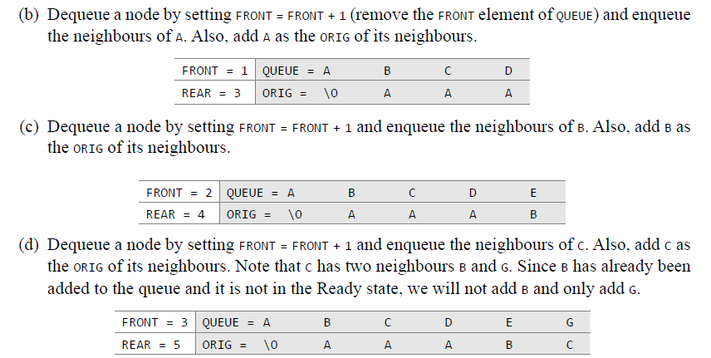

Slide 7
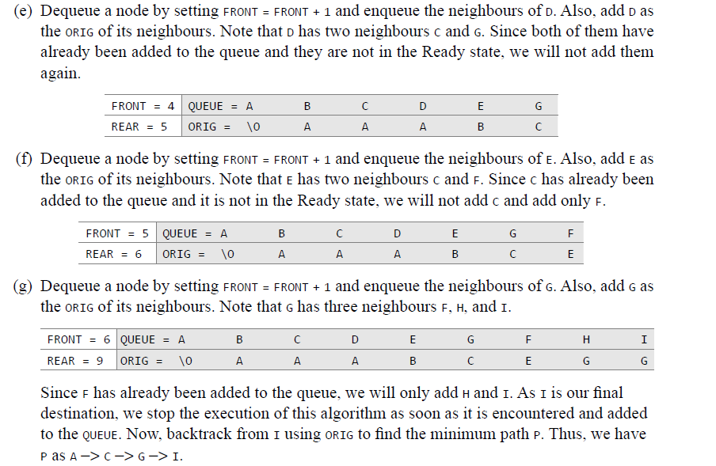

Slide 8
Applications of Breadth-First Search Algorithm
Breadth-first search can be used to solve many problems such as:
Finding all connected components in a graph G.
Finding the shortest between two nodes, u and v, of an unweighted graph and weighted graph.

Slide 9
Depth-first Search

Slide 10
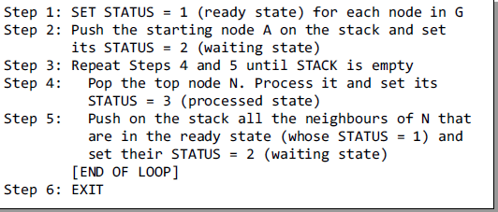
Depth-first Search Algorithm

Slide 11
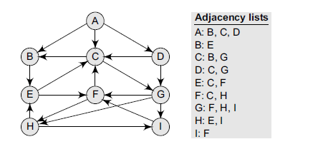
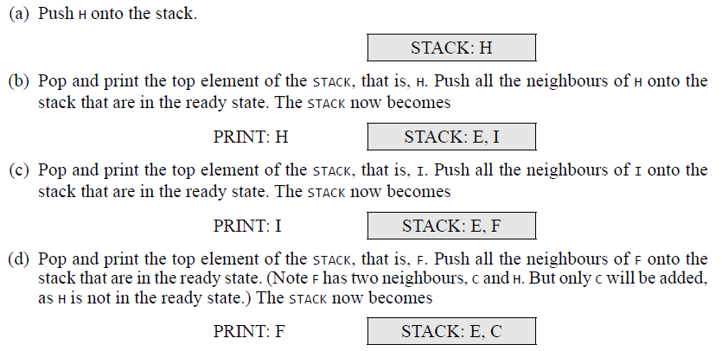

Slide 12
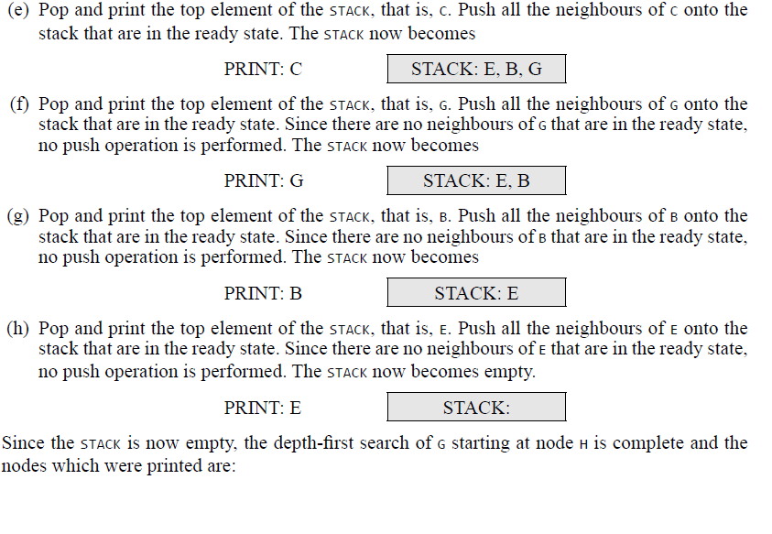


Slide 13
Applications of Depth-First Search Algorithm
Depth-first search is useful for:
Finding a path between two specified nodes, u and v, of an unweighted graph.
Finding a path between two specified nodes, u and v, of a weighted graph.
Finding whether a graph is connected or not.
Computing the spanning tree of a connected graph.

